Slide 1
Graphic novel
Substitute Teacher
Authors:
Ivana Ilić
Dragana Andrić
Moderator: Tatjana Jancić

Slide 2
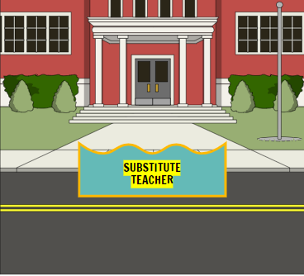
Dragana starts her first day of teaching as a substitute teacher ☺

Slide 3
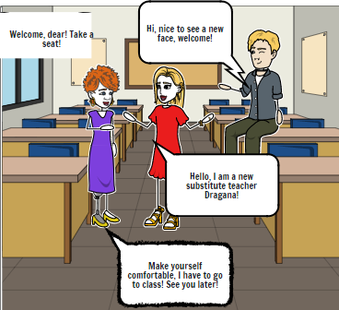
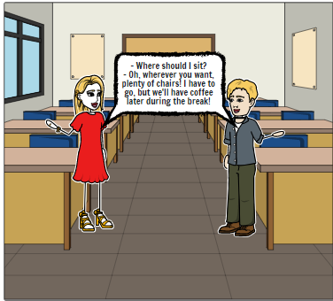
Two colleagues in the staff room are warm and welcoming.

Slide 4
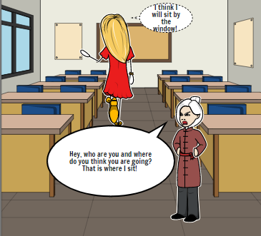
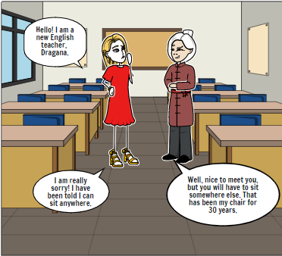
However, things take an unpleasant turn

Slide 5
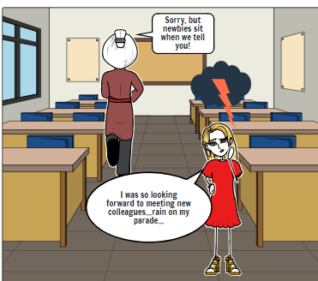
That is not the welcome that she has expected.

Slide 6
THE END!

