Slide 1

Our comic on tolerance
Aleksandra Stošić I2
Anastasija Stamenković I2
Aleksandar Obradović I2

Slide 2
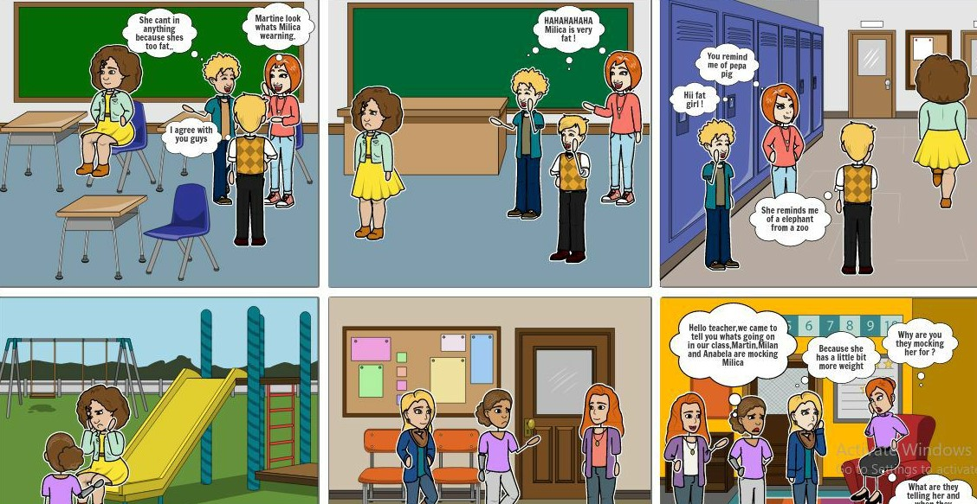
Milica is being bullied. Some of her schoolmates decide to do something about it!

Slide 3
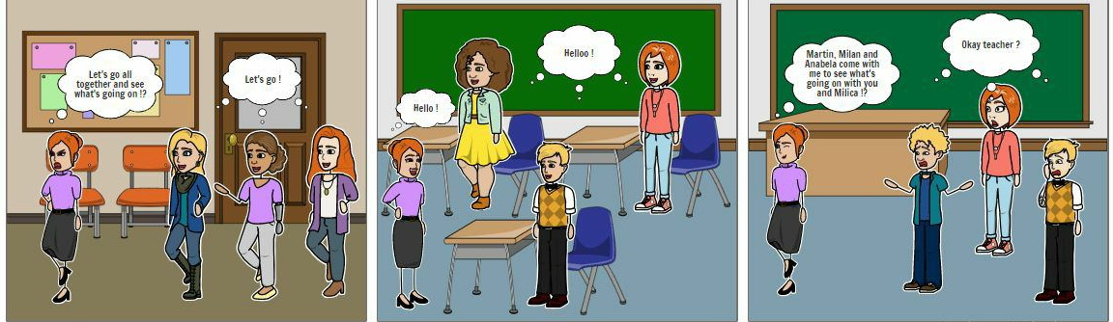
The teacher takes action!

Slide 4
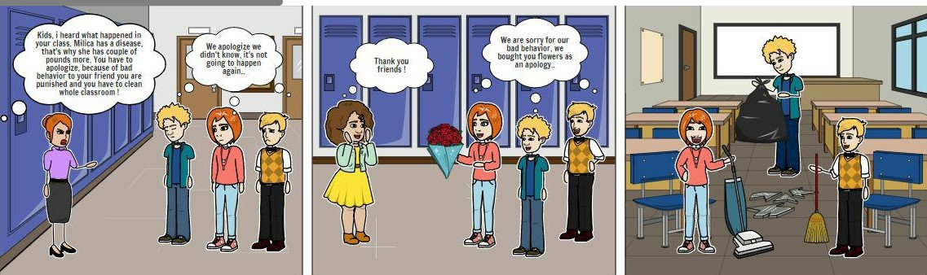
The bullies apologize and get punished!

