Slide 1
TeenAge days
Done by: Novak Jankovic
Luka Deljanin

Slide 2
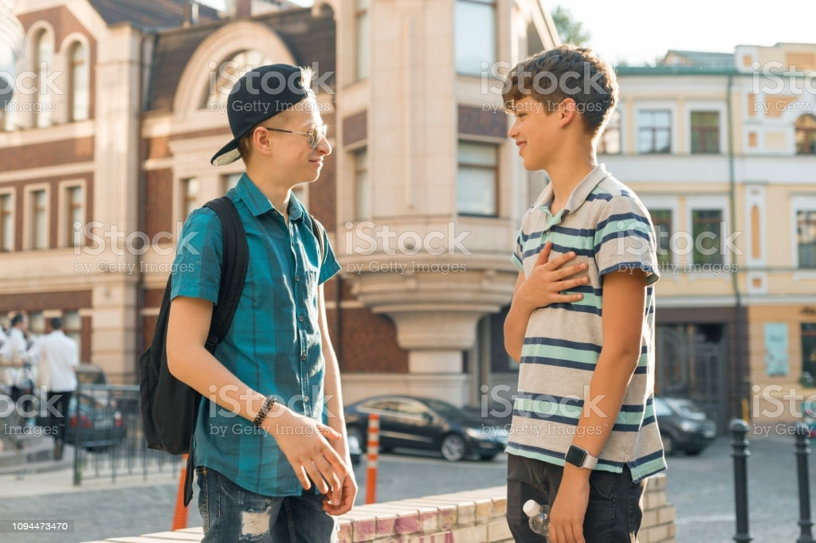
1
My dad taught me to drive, i will drive better then you.
.....

Slide 3

2
Jack what is wrong with you?

Slide 4
Afternoon

Slide 5
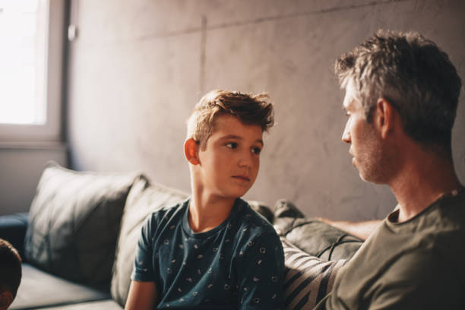
3
You are too young for that. When you are 18 you will study .
Dad my friend drives a car, can you teach me to drive a car?

Slide 6
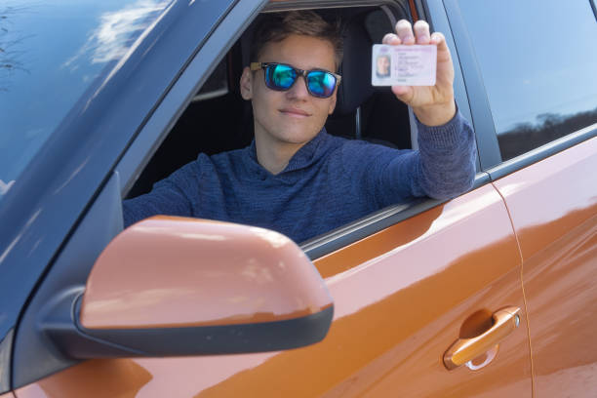
4 One year later the son took a car when he was only 16 years and ran away from home.

Slide 7
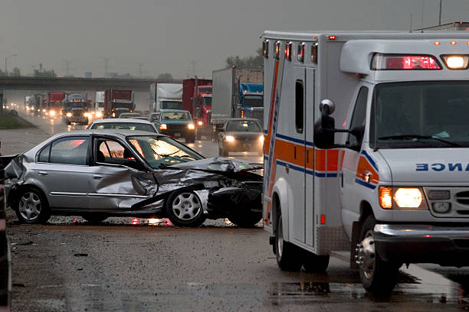
5 During the escape the police caught up with him but he had a car accident

Slide 8
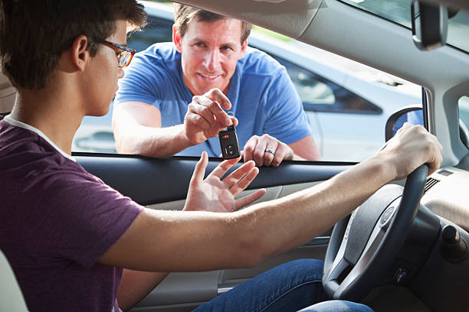
6 After a while Jake recovered and returned home and his father decided to teach him to drive.
Be carefull.

Slide 9
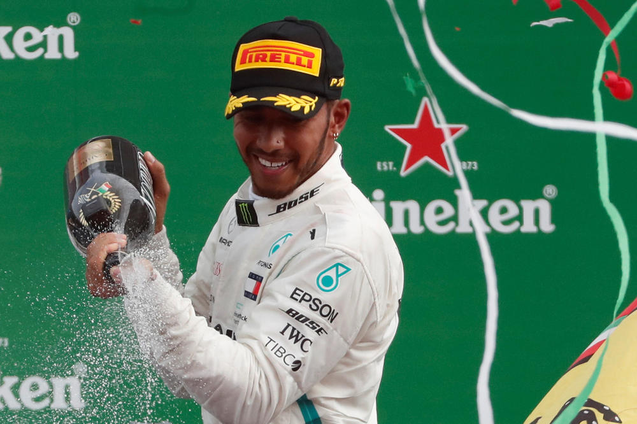
7 After 10 years, Jake became a professional driver and the first in the world
Thank you, dad.

Slide 10
THE END
THANKS FOR READING

