Slide 1

My weekend

Slide 2

WEEKEND
I love weekend.That two days is my favorite days of the week.Days for fun, laugh, family time, chill,picnic,days with my friends.Who can’t love that?
My usually weekend is like that

Slide 3

SATURDAY
I wake up when I want. Basically it’s 10am or 11 am .That is the best part of Saturday. I eat sandwich or rolls for breakfast. After breakfast I call my friends to go in walk with me. i come home before lunch.Lunch is usually around 2pm.I love to eat meat,sausages and potato for early lunch.

Slide 4
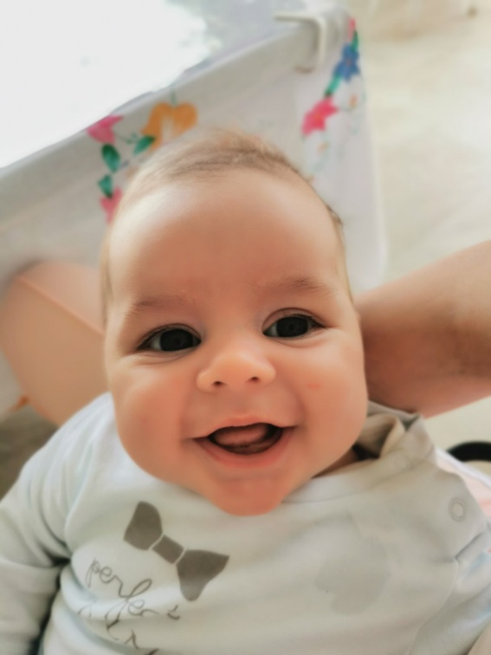
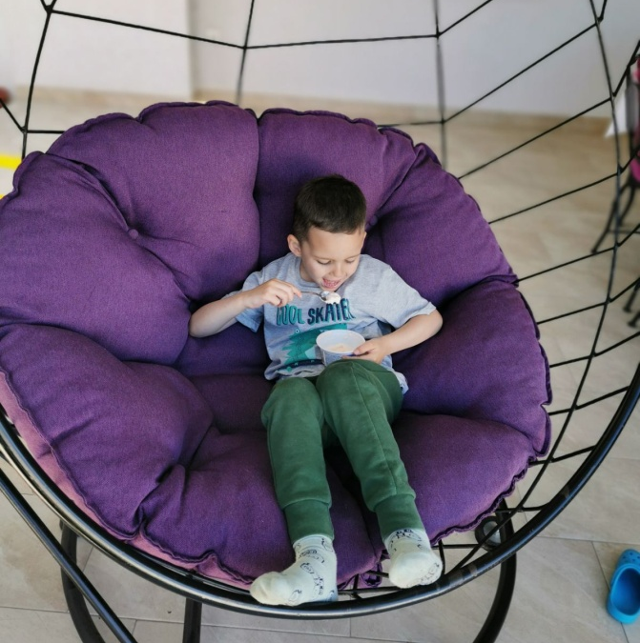
Than I go to my cousins.My cousins are so sweet.My younger cousin Luka always crys beacuse he is a baby.Luka and his older brother live in Backi Jarak. I have a lot of friends in Backi Jarak. So that I always go outside with someone. I go home around 9pm/10pm because I must wake up early tomorrow.

Slide 5

SUNDAY
In sunday morning i wake up in 9 am. that’s not early for someone but for me that’s too hard.I go to Novi Sad because i have a acting sketch. An acting sketch lasts form 12am to 15 am.I love act and this isn't a problem for me.

Slide 6

When I get home I start learning.That’s the worst part of the Sunday.In 11 pm I am tired and i go to the bed.I always in bed check my social media and go to sleep. That’s my weekend.Nothing ultra fun,but this is my rest from school.

Slide 7

Thanks for watching
Worked:Neda Pantos VII

