Slide 1

Discrimination never feels good
Access Vranje: Lara Bundalo, Marko Stošić, Mina Totić

Slide 2
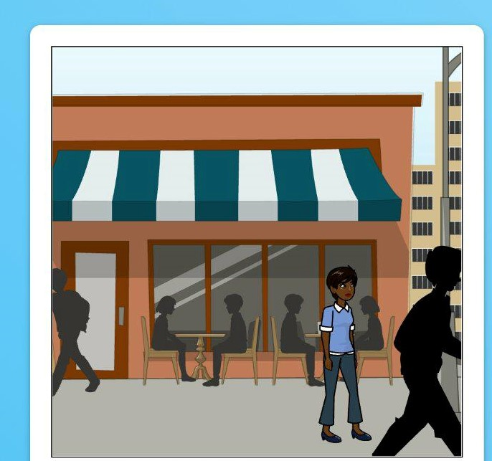
I am in a new country, wearing different clothes and waiting for some new friends I have made to go to the movies.

Slide 3
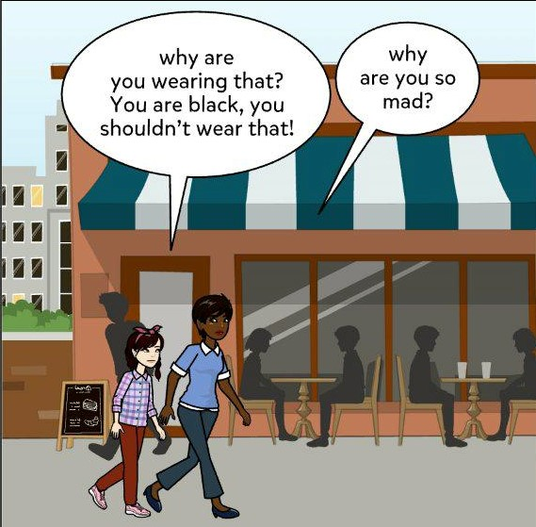
But my new friend Mina makes me feel awkward…

Slide 4
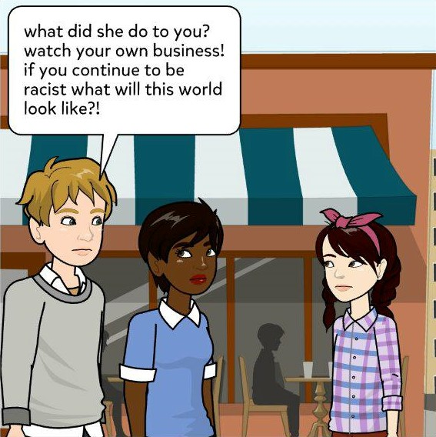
However, Marko comes to my rescue…

Slide 5
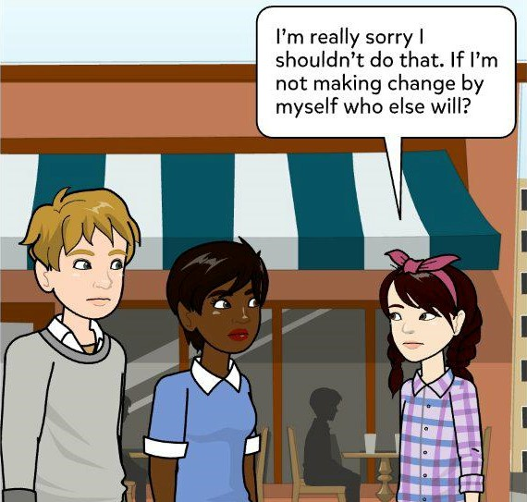
So Mina apologizes. I think she is worried how other people are going to perceive me.

Slide 6
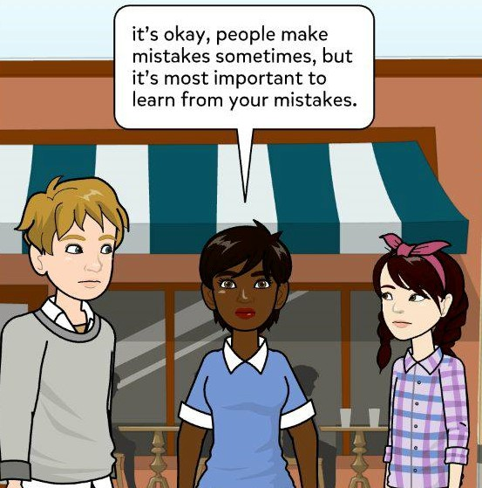
I understand, I have made such mistakes myself but the feeling is not good. Still, I get it….

Slide 7
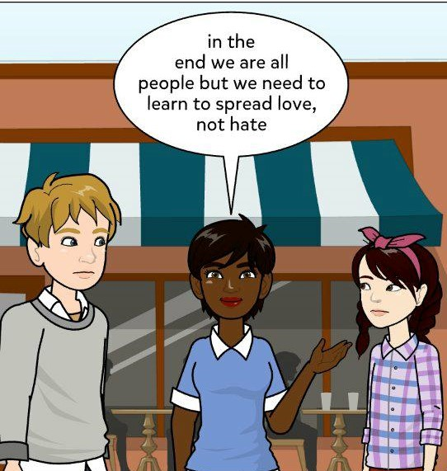
However, our focus on LEARNING to spread love, not hate, is what we are going to do!

