Slide 1
SCHOOL PLAY
by Emilija Kricak

Slide 2


TOLERANCE
This is a story about a group of students who are enrolled in a drama section and need to prepare a play called ,,Romeo and Juliet. “ But they can’t agree on who play the main roll.

Slide 3
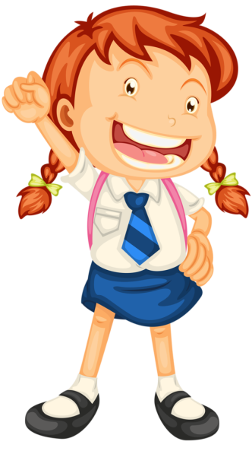



TOLERANCE
There are group five boys and five girls in . Girls named Alice and Ruby quarreled because they both wanted to play Julia. The same situation was with two boys named Michael and Leo.
MICHAEL
ALICE
LEO
RUBY

Slide 4


SITUATION IN THE THEATER
Lets see who will play Julia.
No teacher that role i should get.
Teacher, please, i wont.

Slide 5

The two girls were arguing

Slide 6


Girls slowly, there are more roles.
I want the lead role because im the oldest here.
That role suits me better.

Slide 7

AAGGG
UFFFFF

Slide 8
With the girls, we couldnt decide who would play the lead role. Whether thad probleem exists in your as well
I dont care, i just want to participate in the play, no matter if im the main character or not
I think i am idel for the lead role. And im better that Leo.

Slide 9
Well done Leo if your friends would think as smartly as you.
So I have decided you get the waim role.

Slide 10
In the end it all ended great....

Slide 11
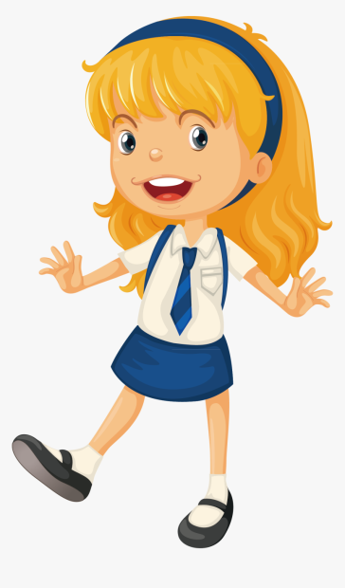

-------
-------
-----------
-------
I am proud of you

Slide 12

Beacuse of their disagreement and disrespect they were expelled from the play.
From this short story we can conclude that we must not be selfish but we should be tolerant just like LEO.

